Slide 1
Affinity Propagation
Clustering Algorithm

Slide 2
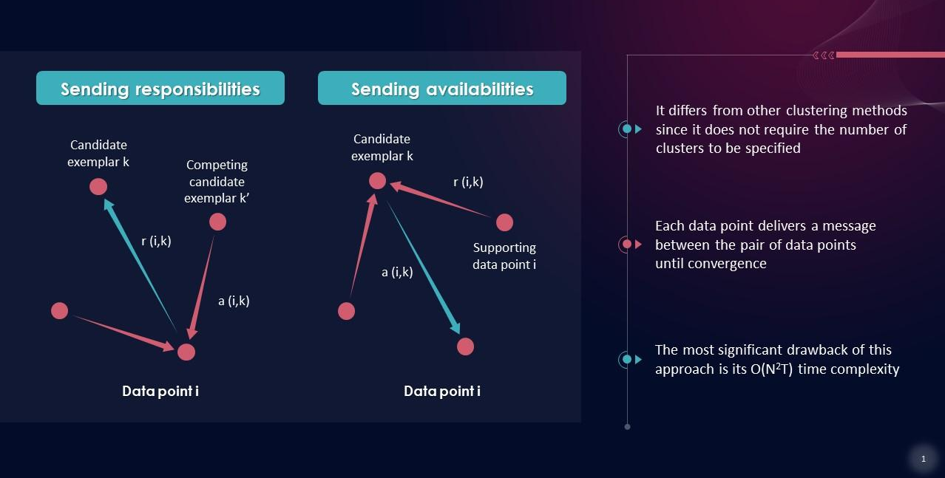
Mechanism Uses a message-passing mechanism between data points to make choices of their own that represents the best clusters.

Slide 3
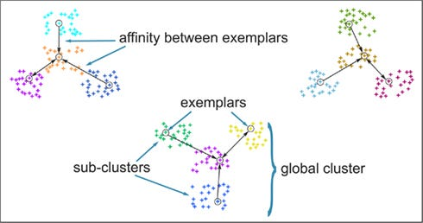
How it Works:
Data points send "messages" to each other based on their similarity, and clusters form around certain "exemplar" points.

Slide 4
Strength
No need to predefine the number of clusters.
Weakness
High computational complexity, not suitable for large datasets.

Slide 5
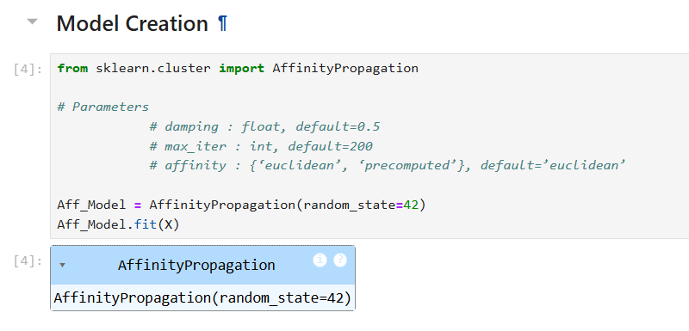
Model Creation

Slide 6
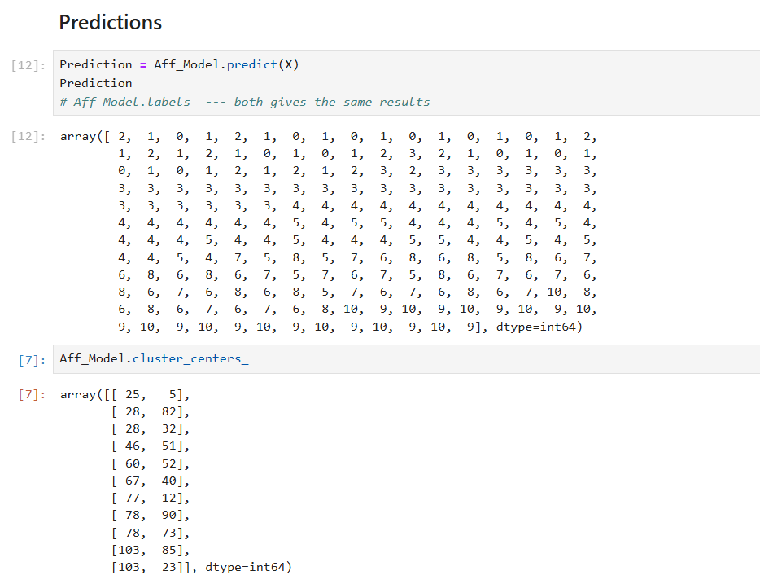
Cluster Prediction

Slide 7
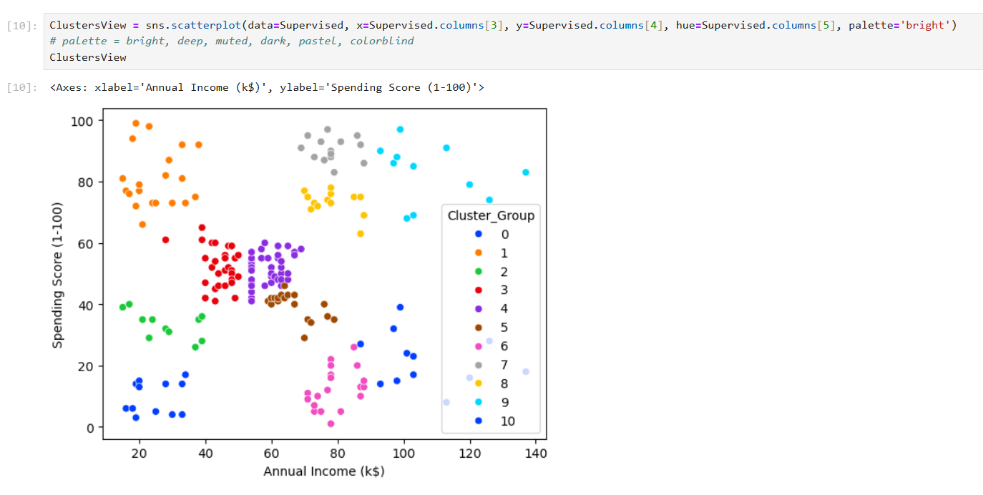
Clusters Visualization

Slide 8
Priyadharshini Manikandan

